Slide 1
Rectal Mucosa
Ian McGowan MD DPhil FRCP
University of Pittsburgh, PA, USA
21st July, 2018
AIDS2018
Amsterdam

Slide 2
Disclosures
Chief Medical Officer at AELIX Therapeutics, Barcelona, Spain
Chief Scientific Officer at Orion Biotechnology, Ottawa, Canada
Chair of the Scientific Advisory Board at ABIVAX, Paris, France

Slide 3
Overview
Rectal susceptibility to HIV/STI
Potential interventions
Rectal microbicides
  State of the science
  Trial findings
  Ongoing and future studies
  Funding for microbicide research

Slide 4
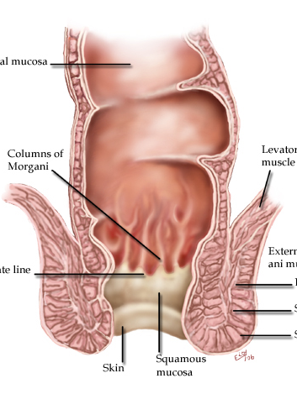
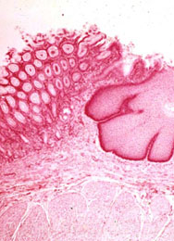
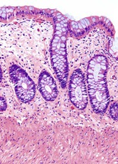
Anatomical Considerations
Notes:
Sagittal section

Slide 5
GALT Vulnerability to HIV
GALT
GALT
CD4+/CCR5+ T cell in blood & gut
PBMC
GALT T cells
Anton PA et al AIDS 2000

Slide 6
Rectal Susceptibility to HIV/STI

Slide 7
Rectal STIs
Bacterial
  Chlamydia, gonorrhea, syphilis
Viral
  HSV, HBV, HCV, CMV, HPV, HIV
Protozoal
  Entamoeba, cryptosporidium, giardia
Microbial dysbiosis

Slide 8
Increasing Incidence of Rectal STIs
Nguyen VK et al AIDS 2018
IRR: Incidence Rate Ratios
Notes:
Objective: Use of preexposure prophylaxis (PrEP) for HIV raises concerns about sexually transmitted infection (STI) incidence because of decreased condom use among MSM. This study examines whether PrEP is associated with STIs in the 12 months following PrEP prescription relative to the 12 months prior to PrEP and if STI rates are higher among PrEP users relative to individuals receiving postexposure prophylaxis (PEP).
Design: Retrospective cohort study including PrEP users with more than 12 months of follow-up before PrEP prescription and individuals receiving PEP from 2010 to 2015 at Clinique l’Actuel (Montre´al, Canada).
Methods: Incidence of chlamydia, gonorrhoea, syphilis and hepatitis C virus over 12 months was compared before and after PrEP; and for PrEP versus PEP users using Poisson models to generate incidence rate ratios (IRRs) with 95% conﬁdence intervals (CIs) and adjusted IRRs (aIRRs) controlling for frequency of STI-screening visits. Models comparing PrEP and PEP users were further adjusted for age and education.
Results: One hundred and nine PrEP and 86 PEP users were included. Increased rates of STIs were observed in the 12 months after PrEP relative to the 12 months prior (IRR: 1.72, CI: 1.22–2.41; aIRR: 1.39, CI 0.98–1.96). PrEP users were also at higher STI risk relative to PEP users (IRR: 2.18, CI: 1.46–3.24; aIRR: 1.76, CI: 1.14–2.71).
Conclusion: Increased rates of STIs among individuals after initiation of PrEP may suggest greater risk behaviours during the ﬁrst year on PrEP. Further studies are needed to measure long-term trends in STI acquisition following PrEP initiation.

Slide 9
Rectal Microenvironment
Burgener A et al. Curr Opinion Immunol 2015

Slide 10
Rectal Microenvironment
Burgener A et al. Curr Opinion Immunol 2015

Slide 11
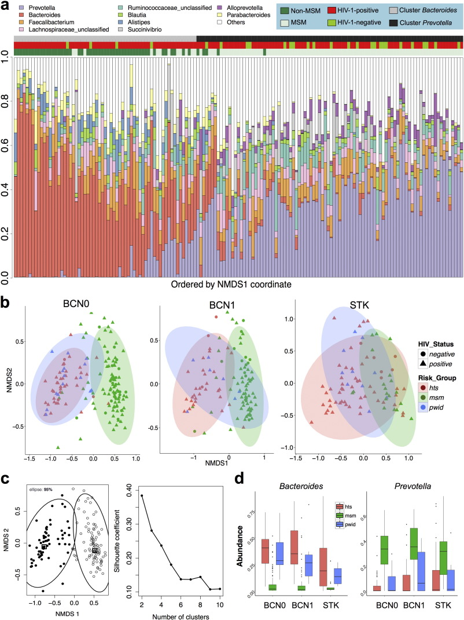
Microbial Dysbiosis
Noguera-Julian M et al. Ebiomedicine 2016
Notes:
The bacterial genus composition of the human fecal microbiome is mainly linked to HIV transmission group. a) The bacterial genus composition of the fecal microbiota in the Barcelona test dataset (BCN0) was largely determined by HIV transmission group, with MSM being enriched in the Prevotella cluster and non-MSM in the Bacteroides cluster. Genera with mean abundance of at least 2% across all samples are represented in colors; those with < 2% abundance are grouped into the category “Others”. Each column represents one individual. A similar plot for the Stockholm cohort is shown in Supplementary Fig. 12. b) Non-metric multidimensional scaling (NMDS) ordination plots of Bray–Curtis distances showing that microbiomes in the BCN0, BCN1 and STK datasets mainly cluster by HIV transmission group (MSM vs. non-MSM) rather than by HIV serostatus. Ellipses include 95% of samples. Similar plots using other distances are shown in Supplementary Figs. 8 to 10. c) Partitioning around medoids (PAM) analysis of the BCN0 dataset showing this population structure in this dataset is better explained by 2 rather than more clusters, with reasonable Silhouette support. This information was used to define the Bacteroides and Prevotella clusters in our study. d) Abundance box plots showing that MSM were enriched in Prevotella and non-MSM (HTS or PWID) were enriched in Bacteroides. Comparisons between MSM and the non-MSM categories were always highly significant (p < 0.001) after adjusting for multiple comparisons using the Benjamini–Hochberg method. Plots of all genera showing significant differences between MSM and non-MSM categories are shown in the Supplementary Figs. 13 to 15.

Slide 12
Prevotella Dominance in MSM
Hts: Heterosexual
MSM: men who have sex with men
PWID: IV drug use
Noguera-Julian M et al. Ebiomedicine 2016

Slide 13
Microbial Dysbiosis
Noguera-Julian M et al. Ebiomedicine 2016
Pescatore N et al. AIDS Res Hu Retro 2018
Notes:
The bacterial genus composition of the human fecal microbiome is mainly linked to HIV transmission group. a) The bacterial genus composition of the fecal microbiota in the Barcelona test dataset (BCN0) was largely determined by HIV transmission group, with MSM being enriched in the Prevotella cluster and non-MSM in the Bacteroides cluster. Genera with mean abundance of at least 2% across all samples are represented in colors; those with < 2% abundance are grouped into the category “Others”. Each column represents one individual. A similar plot for the Stockholm cohort is shown in Supplementary Fig. 12. b) Non-metric multidimensional scaling (NMDS) ordination plots of Bray–Curtis distances showing that microbiomes in the BCN0, BCN1 and STK datasets mainly cluster by HIV transmission group (MSM vs. non-MSM) rather than by HIV serostatus. Ellipses include 95% of samples. Similar plots using other distances are shown in Supplementary Figs. 8 to 10. c) Partitioning around medoids (PAM) analysis of the BCN0 dataset showing this population structure in this dataset is better explained by 2 rather than more clusters, with reasonable Silhouette support. This information was used to define the Bacteroides and Prevotella clusters in our study. d) Abundance box plots showing that MSM were enriched in Prevotella and non-MSM (HTS or PWID) were enriched in Bacteroides. Comparisons between MSM and the non-MSM categories were always highly significant (p < 0.001) after adjusting for multiple comparisons using the Benjamini–Hochberg method. Plots of all genera showing significant differences between MSM and non-MSM categories are shown in the Supplementary Figs. 13 to 15.

Slide 14
Prevotella and Mucosal Inflammation
Potential causes
  Sexual behavior
  Multiple partners
  Condomless RAI
  Parasexual behavior
    Douching
    Lubricant use
  Recurrent STI
  Treatment of STIs
Consequences?
Sui Y et al. Mucosal Immunology 2018
Notes:
It is unknown whether the gut microbiome affects HIV transmission. In our recent SHIV vaccine study, we found that the naïve rhesus macaques from two different sources had significantly different rates of infection against repeated low-dose intrarectal challenge with SHIVSF162P4 virus. Exploring causes, we found that the more susceptible group of seven macaques had significantly more activated CD4+CCR5+Ki67+ T cells in the rectal mucosa than the more resistant group of 11 macaques from a different source. The prevalence of pre-challenge activated rectal CD4 T cells in the naive macaques correlated inversely with the number of challenges required to infect. Because the two naive groups came from different sources, we hypothesized that their microbiomes may differ and might explain the activation difference. Indeed, after sequencing 16s rRNA, we found differences between the two
naive groups that correlated with immune activation status. Distinct gut microbiota induced different levels of immune activation ex vivo. Significantly lower ratios of Bacteroides to Prevotella, and significantly lower levels of Firmicutes were found in the susceptible cohort, which were also inversely correlated with high levels of immune activation in the rectal mucosa. Thus, host microbiome interactions might influence HIV/SIV mucosal transmission through effects on mucosal immune activation.

Slide 15

A Perfect Storm for HIV Infection?
Anorectal dysbiosis
Increasing incidence of STIs
Epithelial damage
Vulnerable GALT T cells
Impact on PrEP efficacy?

Slide 16
Potential Interventions

Slide 17
Interventions to Reduce STIs
Behavioral
  Partner reduction and condom use
Enhanced STI screening and treatment
Antibiotic pre-exposure prophylaxis
Microbicides

Slide 18
Rectal Microbicides

Slide 19
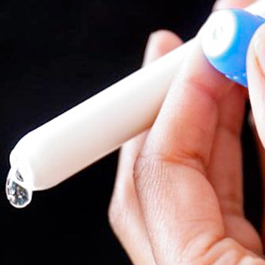
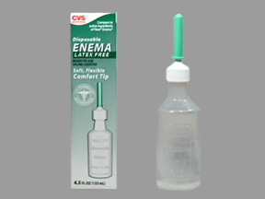
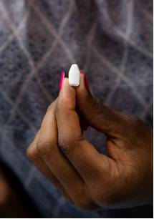
Rectal Microbicide Formulations

Slide 20
Would They Work?
“HIV” (^{99m}Tc-SC) in Ejaculate
“Microbicide”(¹¹¹In-DTPA)
CHARM-02 Study (Hiruy H et al. AIDS Res Hum Retroviruses 2015)

Slide 21
Where is the Science?
Good non-clinical animal model data to support the safety and effectiveness of topical PrEP agents including candidate rectal microbicides
Multiple products have advanced through Phase 1 evaluation generating supportive safety, acceptability, and PK/PD data
A tenofovir gel has been evaluated in a Phase 2 international multicenter study (MTN-017)
As of yet no Phase 2B/3 effectiveness studies

Slide 22


Slide 23
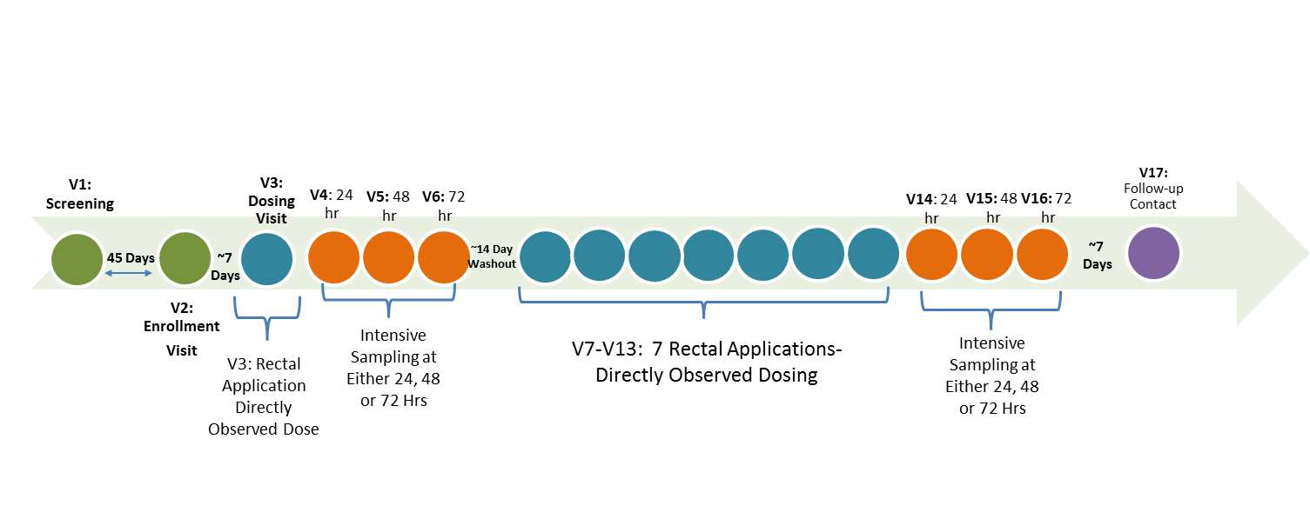
MTN-026
Phase 1 rectal safety, acceptability, and PK/PD evaluation of dapivirine gel
N = 27
Clinical sites
  Pittsburgh, Birmingham, and Bangkok

Slide 24
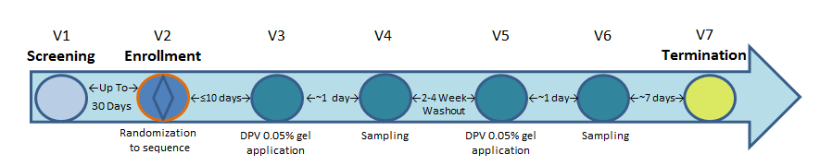
MTN-033
Phase 1 evaluation of dapivirine gel to determine whether digital / phallic insertion equivalent to applicator insertion of microbicide
HIV-uninfected men who have sex with men (MSM) and transgender females who have sex with men, 18 years or older (N=16)

Slide 25
MTN-037
Collaboration with the Population Council
Phase 1 dose escalation of MIV-150/Carageenan/Zinc gel
Potential activity against HIV. HPV, and HSV-2
Safety, acceptability, and PK/PD
  Group 1: 4 mL of gel
  Group 2: 16 mL of gel
  Group 3: 32 mL of gel
Status: Ongoing

Slide 26
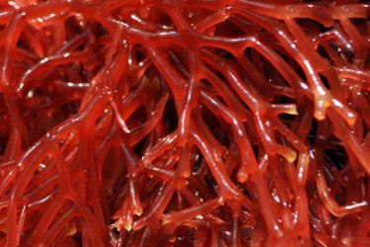
DREAM and PREVENT Programs
DREAM Program
PREVENT Program
Tenofovir
prodrug enemas
PI: Craig Hendrix, JHU
Griffithsin rectal gel
PI: Kenneth Palmer, University of Louisville
Notes:
Natural product Griffithsin isolated from Griffithsia, red alga originally collected off Chatham Island New Zealand
Griffithsin is a lectin, one of the most potent HIV-1 entry inhibitors
Targets the dense clusters of sugars (glycans) present on the surface of HIV
Efficiently manufactured in Nicotiana benthamiana plants

Slide 27

OB-002H (5P12 RANTES) Phase 1

Slide 28
Screening Visit
Enrollment Visit
Single Vaginal Dose Exposure Visit (N = 6 female participants)
Five Daily Vaginal Dose Exposure Visit (N = 18 female participants)
OB-002H: HEC placebo gel (2:1)
Follow-up visit
Single Rectal Dose Exposure Visit (N = 6 male or female participants)
Five Daily Rectal Dose Exposure Visit (N = 18 male or female participants)
OB-002H: HEC placebo gel (2:1)
Follow-up visit

Slide 29
Broad Spectrum STI Microbicides
Tenofovir (HIV, HBV, HSV)
Population Council (HIV, HSV, HPV)
Bacterial STIs
  Antimicrobial peptides
    Octglycerol¹
    LL-37²
¹Wang et al. Drug Dev Ind Pharm. 2012
²Srakaew N et al. Human Reproduction 2014

Slide 30
So Is It Possible?
In the absence of federal or philanthropic funding moving a candidate rectal microbicide through to licensure will be very challenging.
Big Pharma have the resources and the capacity to make this happen
  Less certain if they have the interest to do so as this would canabalize the oral PrEP franchise and/or emerging approaches such as IM cabotegravir

Slide 31
Summary
The rectal mucosa continues to be a major portal of entry for HIV infection
PrEP is a huge advance for HIV prevention but may lead to increases in condomless sex and associated anorectal STIs
Further work need to define the role of the microbiome in vulnerability to HIV infection
Rectal microbicide development continues but funding will become a critical issues in the next 1-2 years

Slide 32
Thank You

